Slide 1
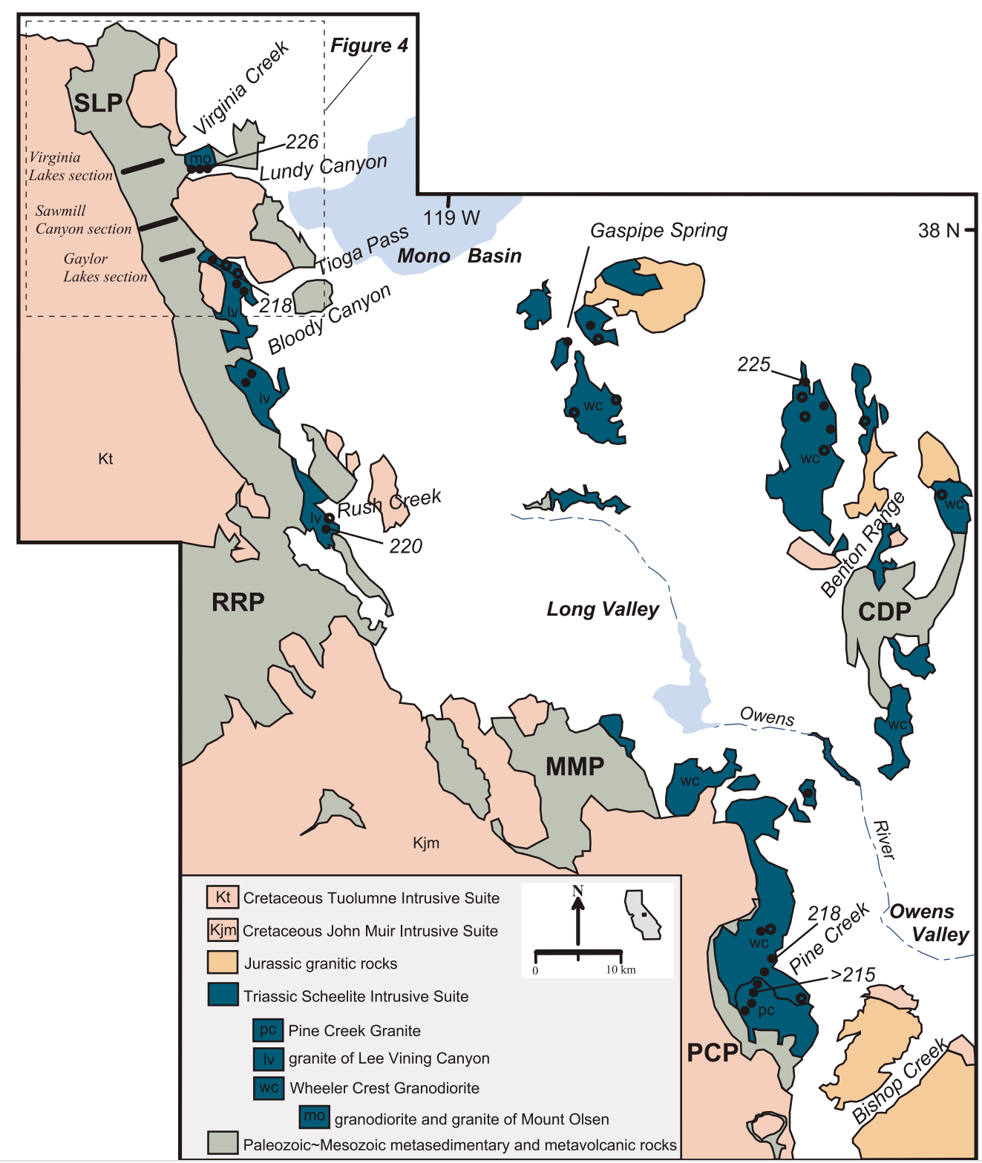
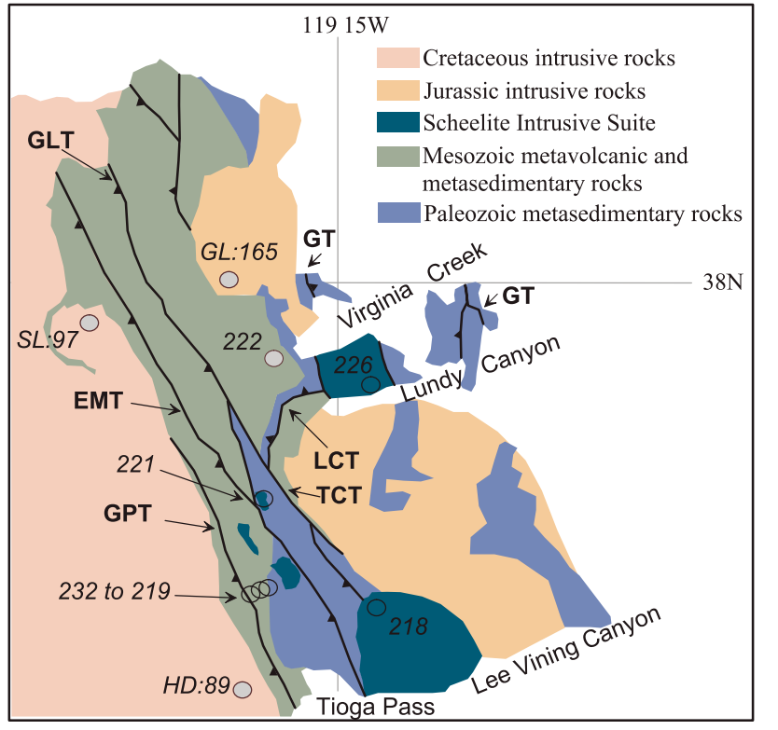
Petrology of the Sierra Nevada Arc
Barthel et al 2011
Ryan Parkyn

Slide 2
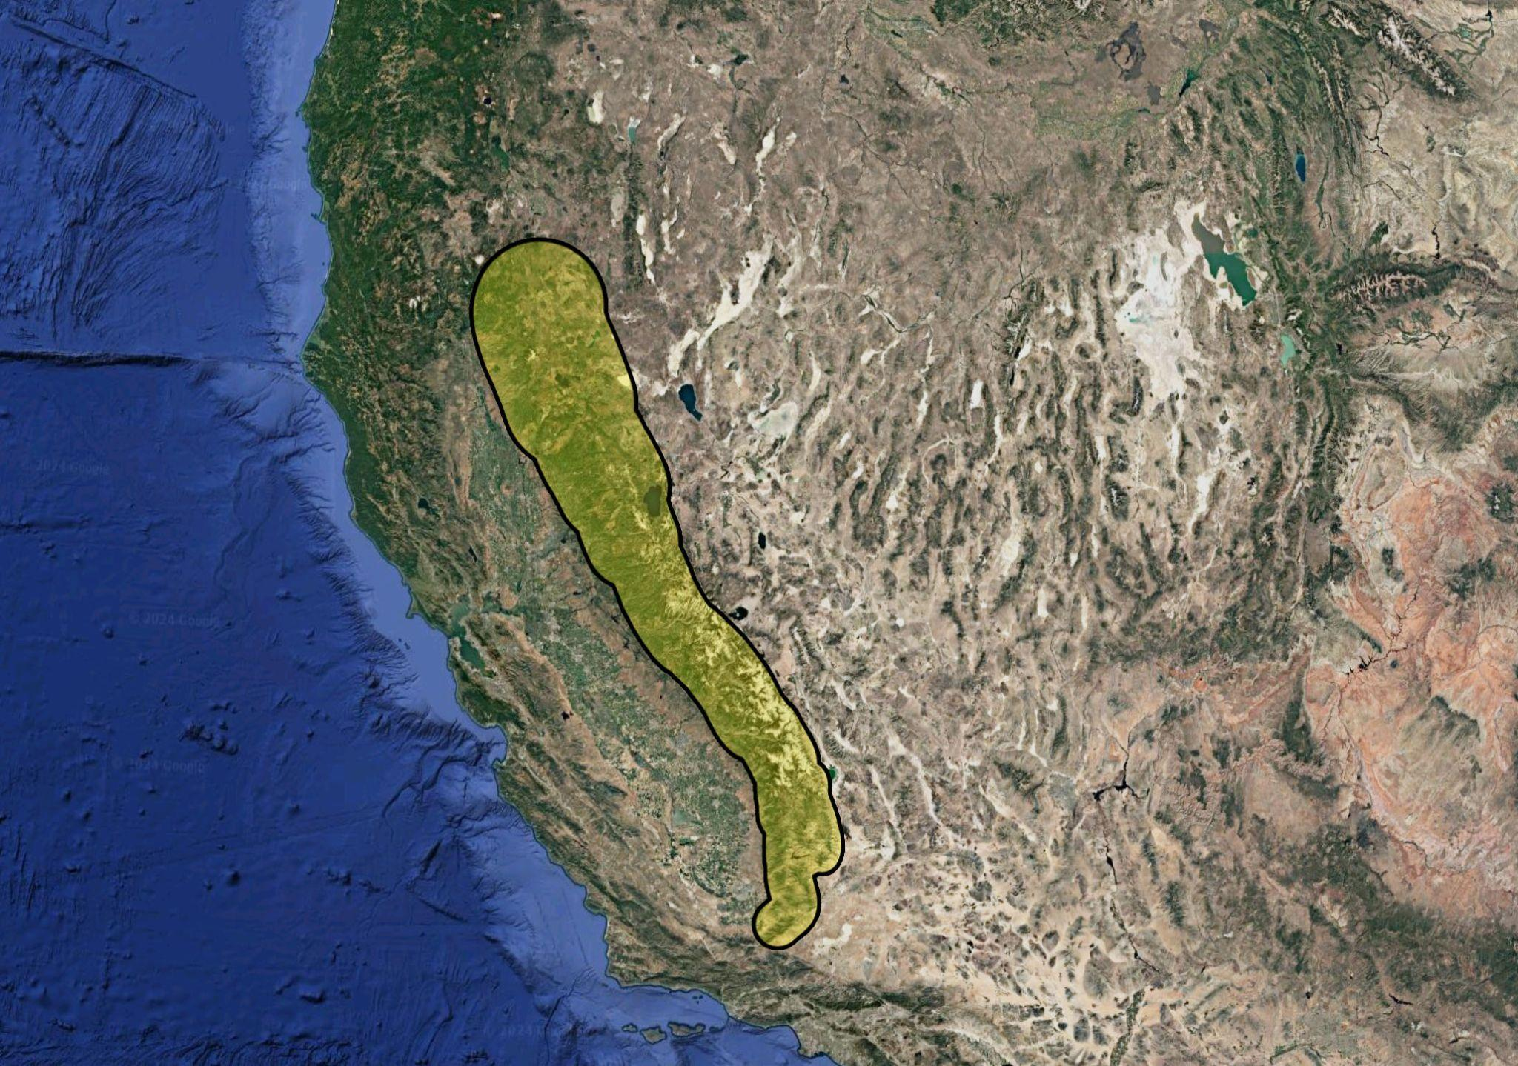
Study Area/Method
Collected samples
Acquired whole rock glass compositions (XRF)
Ages + Major + H/L REE data (ICP-MS, SHRIMP-RG)
Plotted ages on map
Plotted majors + REE
Reno
Sacramento
Las Vegas
Notes:
XRF = Xray fluorescence
ICP MS = inductively coupled plasma mass spectrometer
SHRIMP RG = sensitive high resolution ion microprobe reverse geometry

Slide 3
Goals
Study the earliest magmatic rocks of Sierras
Examine magma sources and investigate relationship btw metavolcanic + plutonic rocks
Reno
Sacramento
Las Vegas
Notes:
XRF = Xray fluorescence
ICP MS = inductively coupled plasma mass spectrometer
SHRIMP RG = sensitive high resolution ion microprobe reverse geometry

Slide 4
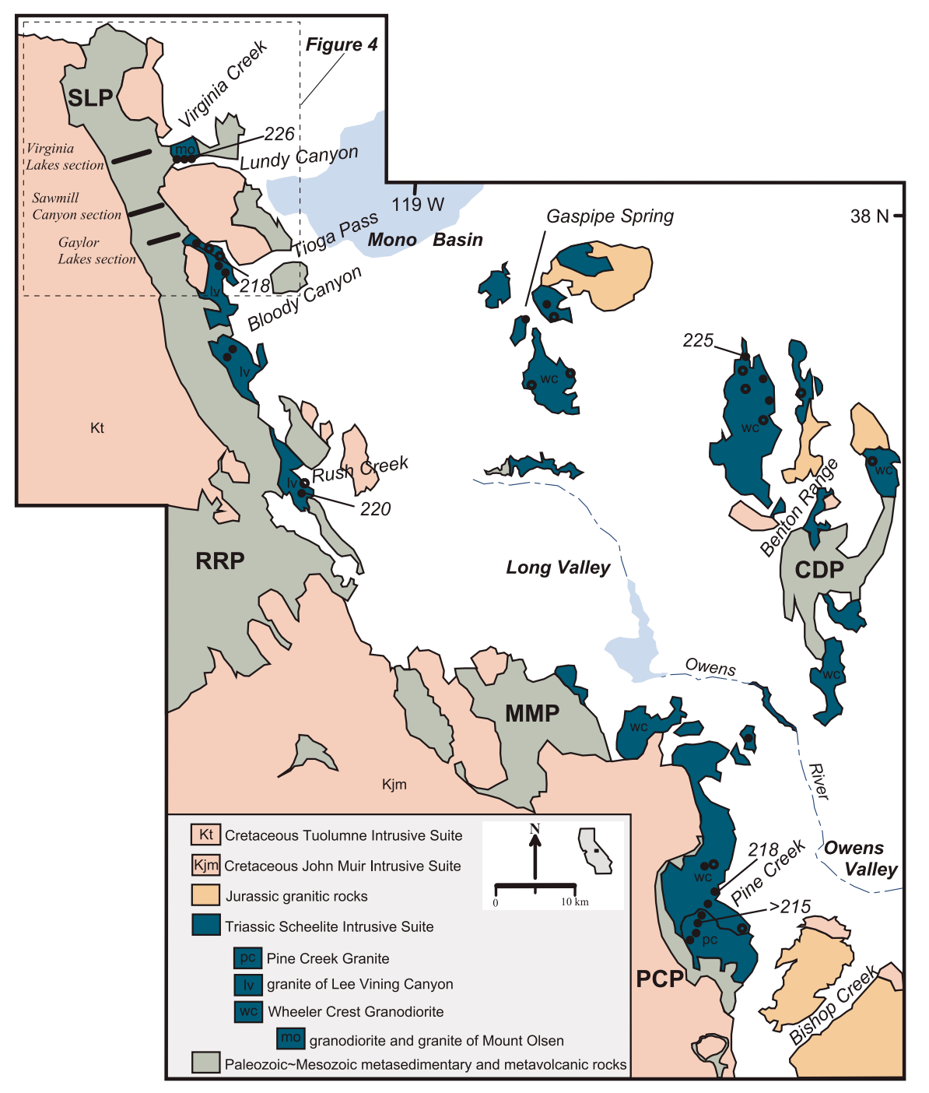
Geologic Map
Cretaceous, Jurassic, Triassic plutonics
Overlying Paleozoic-Mesozoic metasedimentary And metavolcanics
Koip Sequence: ash flows, 225Ma
Schellite Intrusive Suite: Triassic Pluton, 226-218Ma)
“Pendants” -> overlying meta rocks + Plutonic Triassic Rocks
Notes:
CDP—Casa Diablo Pendant
MMP—Mount Morrison pendant
PCP—Pine Creek pendant
RRP—Ritter Range pendant
SLP—Saddlebag Lake pendant
SIS is Calcic plutonic suite, but adjacent to compositionally similar high K late cretaceous intrusives
Koip sequence = entirely late triassic, consistent with zircon ages across multiple exposed pendants
Ash flow tuffs of Koip Sequence sets a basis of understanding for timing of subduction and onset of volcanism
^ These rocks are hydrothermally altered but compositionally similar to contemporaneous granodiorite/granite of SIS
^Assembly if SIS occasioned eruption of large volume dacite/rhyolitic ignimbrites (Thru Nd and +3 and +4 isotopes)
Explosive silicic volcanism occurred prior to Mesozoic plutonism but continued into plutonism onset
Volcanism had begun by 232Ma (tuff of black mtn, Koip Seq), but 242-250Ma via detrital zircons from Great Valley forarc
SIS = Wheeler Crest Granodiorite, Lee Vining Canyon Granodiorite, Pine Creek Granite (226-218Ma assembly) somewhat coeval with Koip Sequence

Slide 5
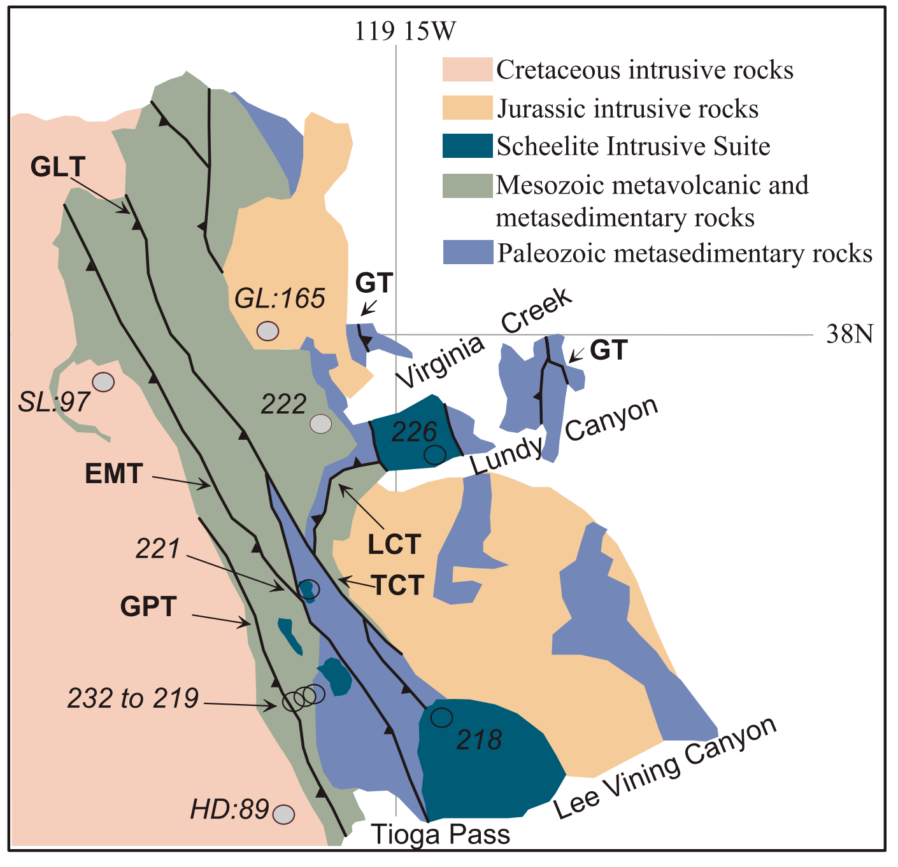
Geologic Map
Smaller-scale map of previous figure
Transect ages along imbricated faults constrain fault ages
Prev authors: Lundy Canyon Thrust is triassic
Triassic Pluton is identical in age to adjacent tuffs imbricated by fault, so thrust is younger than tuff (<224 Ma)
Notes:
Gray circles are U-Pb zircon sample localities for adjacent rock units
Jurassic Green Lakes (GL) pluton
Cretaceous Soldier Lake (SL) pluton localities
Cretaceous Half Dome (HD) granodiorite age
Virginia Creek locality is age of tuff of Saddlebag Lake cited by Schweickert and Lahren (1999).
EMT—Excelsior Mountain thrust,
GLT—Glenberry Lake thrust,
GPT—Gaylor Peak thrust,
GT—Golconda thrust,
LCT—Lundy Canyon thrust,
TCT—Tioga Crest thrust.

Slide 6
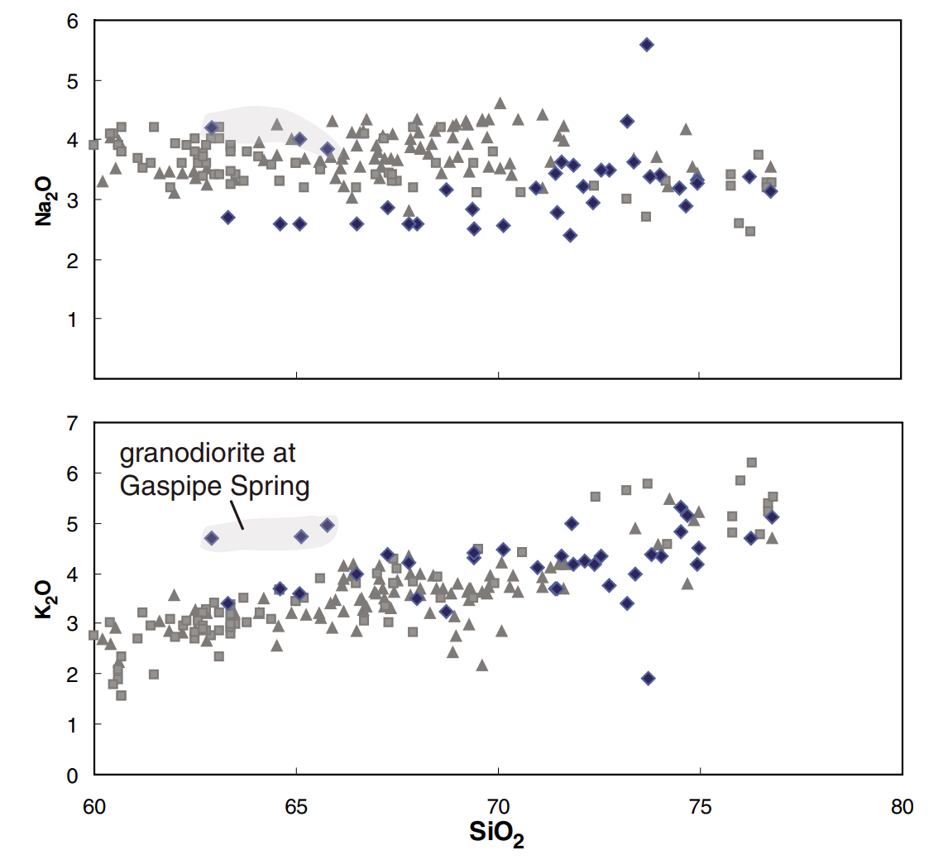
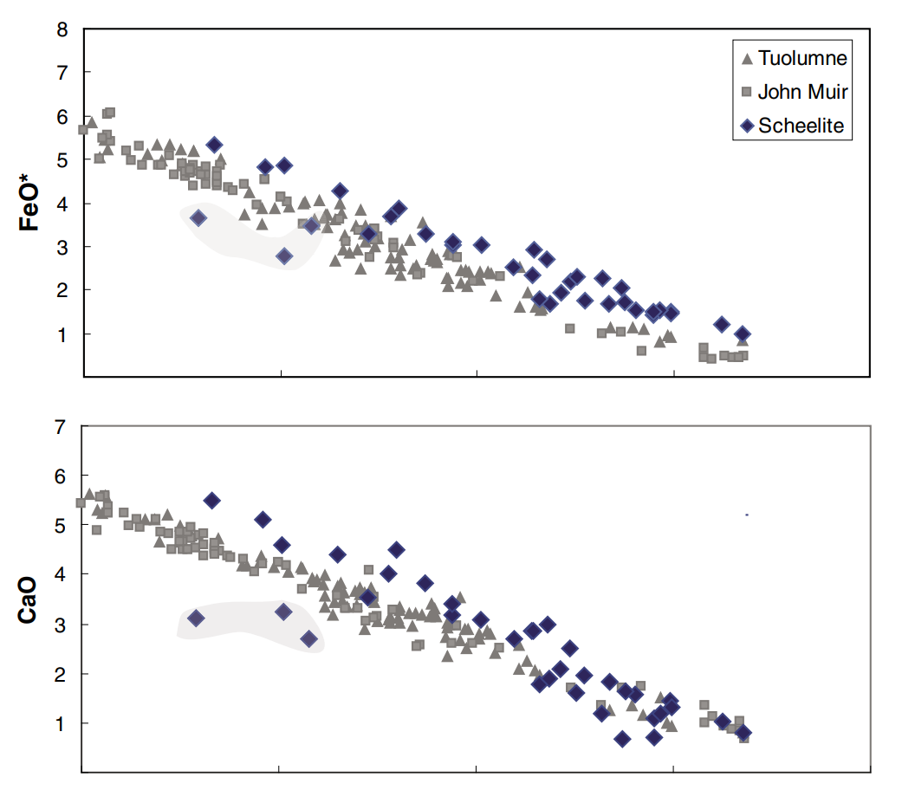
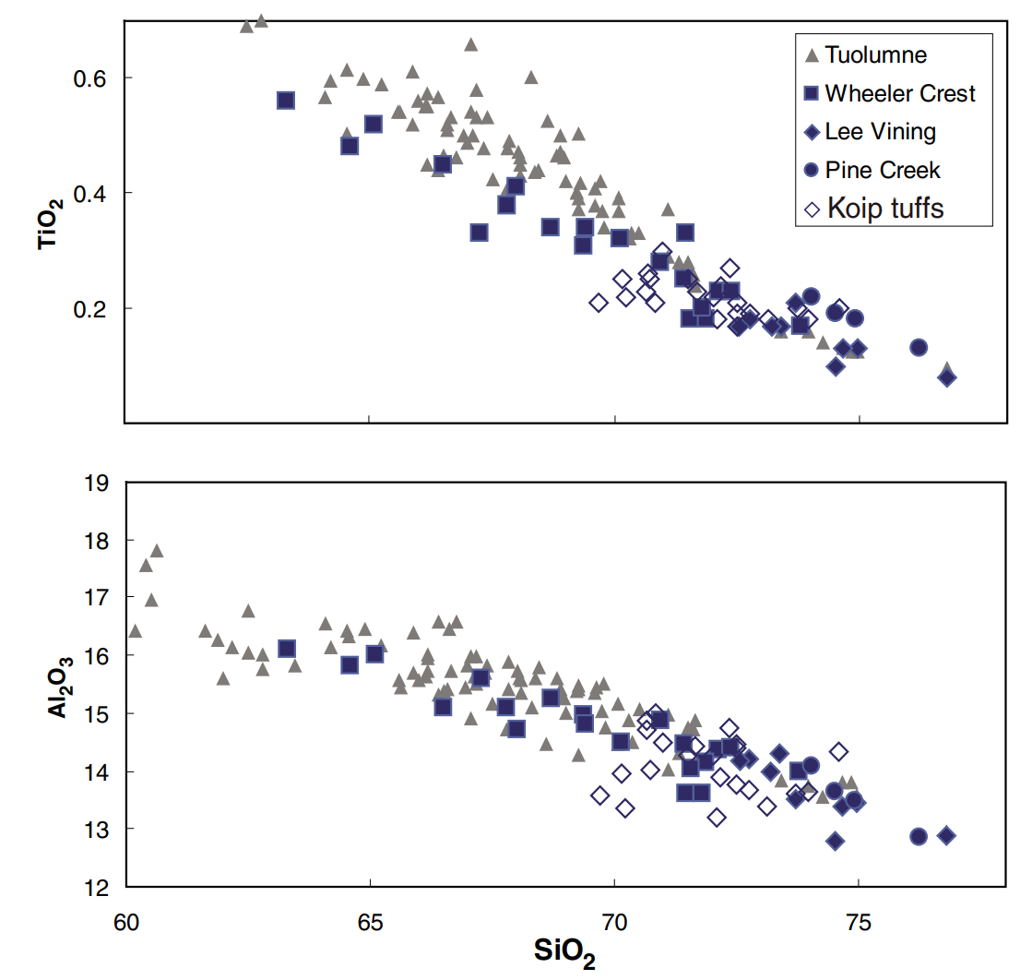
Major Element Harker Diagrams of Sierra Nevada Batholithic Rocks Show Net Magma Composition
Increasing SiO2
Major element Harker diagrams show identical chemical trends

Slide 7
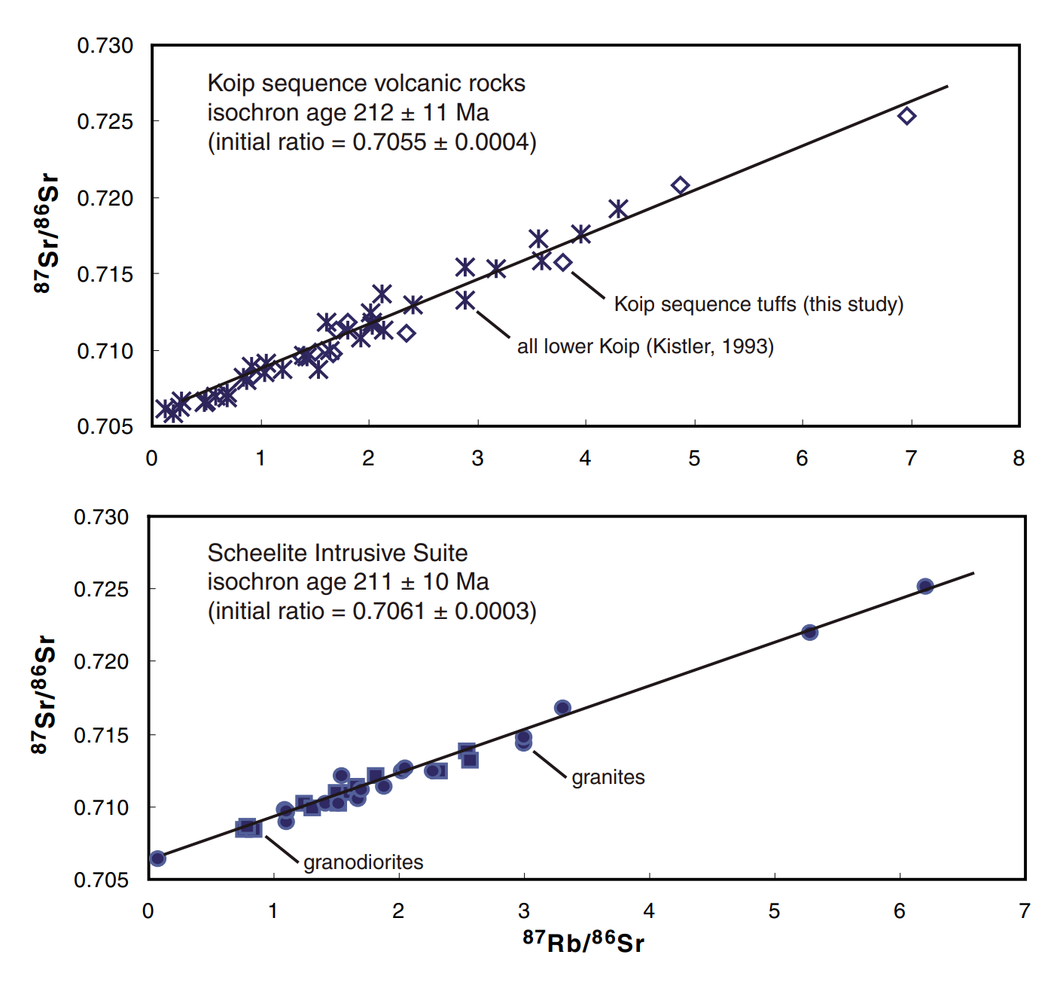
Rb-Sr Data Illustrates Volcanic rocks and Plutonic Rocks are related
Notes:
2 graphs one is sheelite intrusive suite one is koip sequence
Shows plutonic and volcanic differentiation share the same trend = genetically related
Nearly the same isochron age and initial strontium ratio

Slide 8
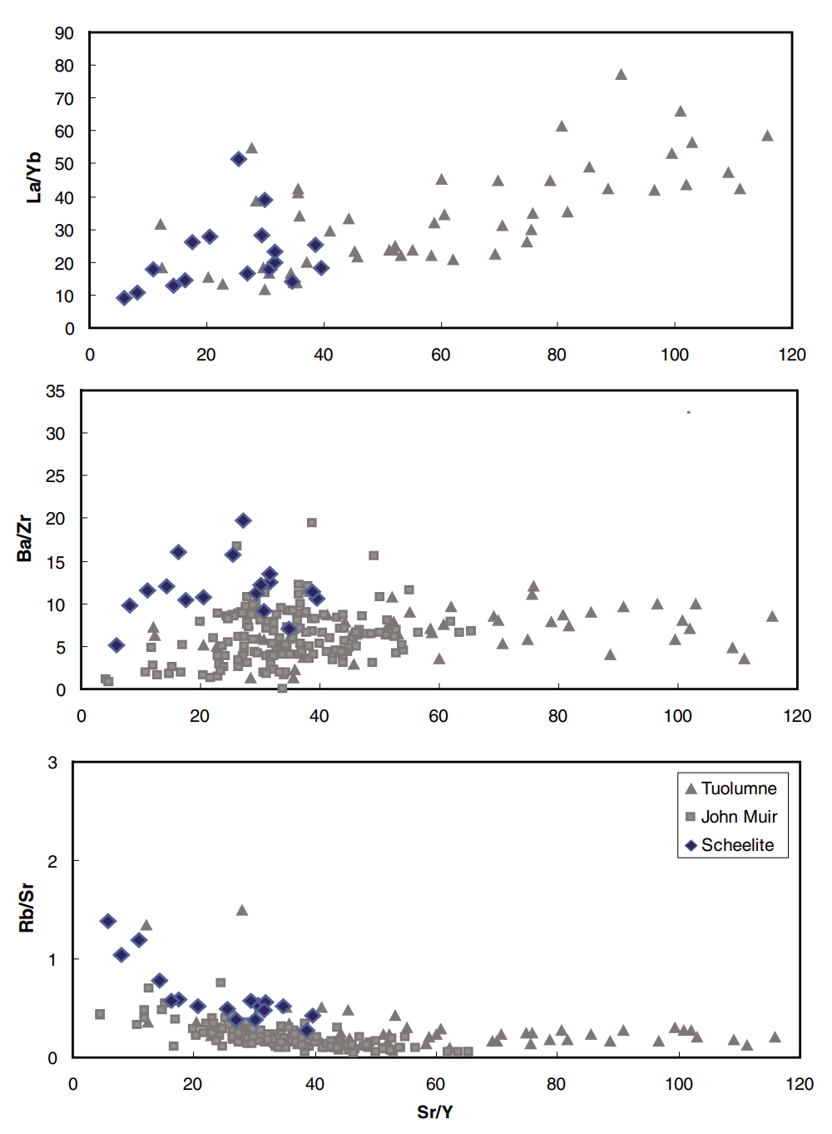
REE Data Shows Magmas are Derived from Various Sources
Notes:
Tuolumne Intrusives + granodiorites of SIS = isotopically identical, but lower Sr/Y and lower La/Yb ratios imply mixing btw mantle derived parental SIS basalt magmas + feldspar rich crustal sources compared to tuolumne intrusive suite

Slide 9
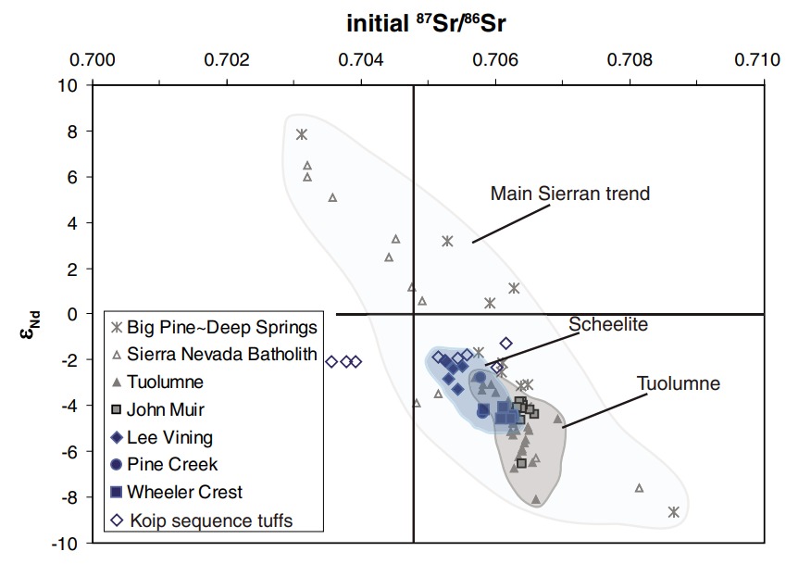
Increasing 87Sr/86Sr: Increasing crustal component
Increasing ε: Increasing Depleted mantle signature
Mantle derived
220Ma
Crustal derived
Notes:
e-Nd= Chrondrite normalized value representing the how much the ratio of 143Nd/144Nd deviates from a chrondrite
(plus) e-Nd = depleted mantle source
(minus) e-Nd = Crustal or enriched mantle source
Overall a high Sr87/Sr86 ratio means there is more of a crustal component in a melt
High e and low Sr/Sr = Depleted mantle
Low/negative e and high Sr/Sr = enriched crust
Trend = mixing btw crustal and mantle derived materials
SIS discontinous due to younger volcanic cover, but petro data illustrates that SIS shares common heritage with younger and better exposed late cretaceous sierra nevada batholithic rocks -> comparisons between suites suggest changes in magma sources with time during sierran arc
^ Story of differentiation is more complex than simpe fractionination, magma mixing

Slide 10
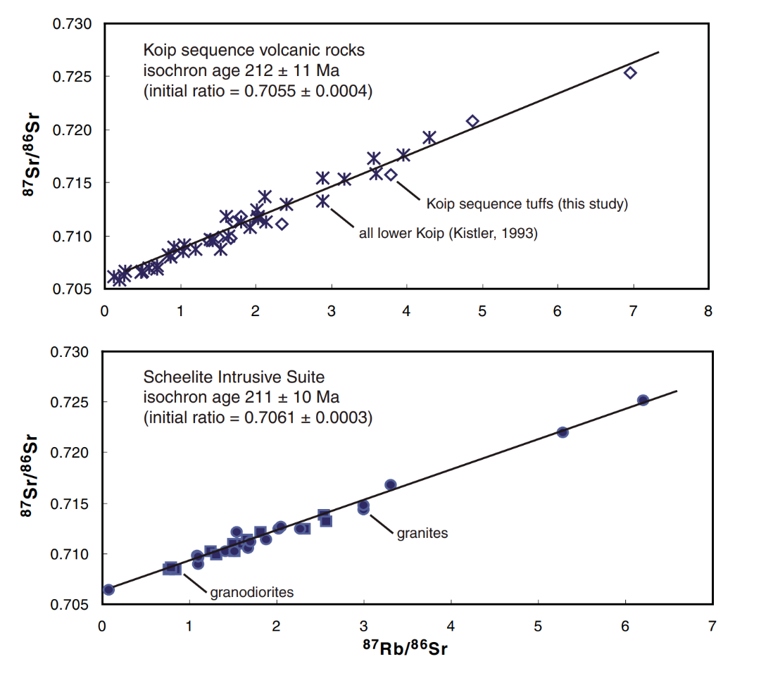
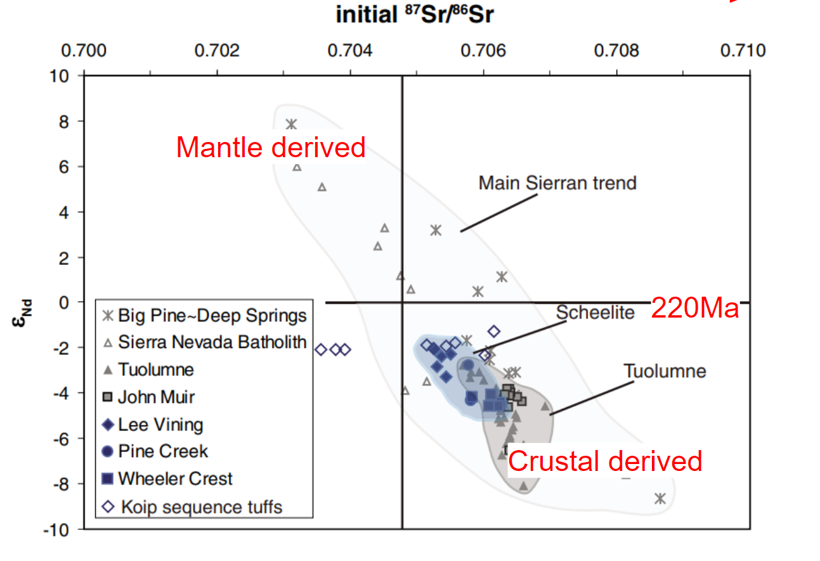
Summary
Triassic and Late Cretaceous suites are nearly indistinguishable in composition
…but their isotopes vary remarkably between Triassic and L Cretaceous suites
Felsic ignimbrite onset was before/and coeval w plutonism (silicic tuffs: 232, 224, 219Ma)
(Scheelite Intrusive Suite: 226-218Ma)

Slide 11
Granitic and Volcanic Rocks in the Sierra Nevada Mountains Record Earliest Stages of Arc Magmatism
Their 226Ma ages are consistent with a regional imbricated thrust system, thrust is younger than tuff of saddlebag lake
Saddlebag lake pendant = shallow marine uplifted, triassic arc formed on accreted basement rocks -> further evidence is Wassuk Ranges and Yerington in W Nevada where small plutons interfinger/overlay Norian carbonates
Magmatism in the northern and southern arc was ongoing by Middle Triassic (Plutonic +volcanic + DZ) -> likely commenced around 250 Ma

